Slide 1
Examination and Assessment of the Neonatal Pediatric Patient, Pulmonary Function Testing and Bedside Pulmonary Mechanics, Radiographic Assessment
Name
Institution
Course
Instructor
Date

Slide 2
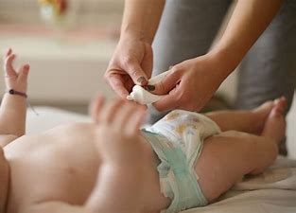
Physical Examination of the Neonate
Observations done by;
  Checking the behavior of the arm
  Pressing the sole of the arm or foot
Notes:
Depending on the clinical situation, physical examination of an infant requires modification of examination order. The normal heartbeat of an infant is between 120 and 170 beats every minute. Physical examination of an infant is also done by observing their appearance. Such observations may include checking the behavior of the arm, whereby the child unable to symmetrically move their arms would have their clavicle being broken or injured. Additionally, the capillary takes three seconds or less to refill. To assess this, one should press the sole of their arm or foot. Skin observation in infants is essential because it helps in diagnosis. For instance, when it is reddish-blue, it signifies a high value of hematocrit(Walsh, 2018).

Slide 3
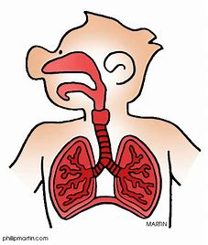
Physical Examination of the Neonate
Respiration rate should be between 40 and 60 per minute
The circumference of the newborn’s chest should be equal to the circumference of their heads.
Notes:
The physical examination can also be carried out on respiratory functioning. For newborn babies, their rate of respiration is between 40 and 60 seconds for every minute. Various factors influence this rate, and the providers should examine the respiration rate to detect any irregularity. Apnea is one condition that is characterized by the ceasing of breath for more than 20 seconds. For the chest, the newborns have their circumference being equal to the circumference of the head. Otherwise, they may have such malformations as protruding xiphisternum. For the abdomen, the person carrying out examination observes the abdomen's contour of the infant when they are quiet and calm. Through this examination, the examiner can detect such abnormalities as omphalocele and prune-belly syndrome.

Slide 4

Physical Examination of the Neonate
Other forms of Physical examination include;
    Crying
    Neurologic assessment
    Chest walls percussion
    Auscultation
Notes:
The physical examination can also be carried out in such aspects as crying. For an infant, having a vigorous and loud cry may signify a healthy child. A child may show signs of illnesses if they have a faint cry or are moaning. Other forms of physical examination in children include neurologic assessment, chest walls percussion, and auscultation, where the examiner listens to the sounds that lungs and heart produce. The ears can give good results, but a stethoscope may be more effective(Walsh, 2018).

Slide 5
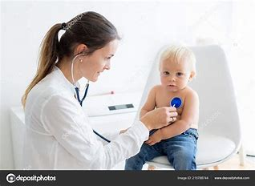
Physical Examination of the Neonate
Auscultation
Involves assessing the sounds of the gastrointestinal tract, lungs, and the heart.
Examiners can use ears or stethoscope
Audible voices are wheezes and crackles
Stethoscope is more effective than ears
Notes:
This is where the examiner listens to the sounds of the gastrointestinal tract, lungs, and heart. This is mainly done using ears, but a stethoscope serves this purpose more effectively. During normal breathing, no sound is heard using a stethoscope. This means that any noise that is audible during this quiet time shows that there is abnormality. Other noises that are experienced during auscultation include wheezing, stertor, and stridor. Using the stethoscopes, the audible voices include wheezes and crackles. For effective results, auscultation should be carried out when the infant is quiet and calm. Through this process, the examiner assesses the symmetry and intensity of breath(Walsh, 2018).

Slide 6

Physical Examination of the Neonate
Non-Pulmonary Examination
It involves;
  Growth assessment
  Examination of body parts
Notes:
These examinations involve; growth assessment such as height, weight, and their percentiles; examination of other body parts such as skin, heart, nose, ears, eyes, throat, abdomen, etc., to recognize the contributing or underlying conditions. Several conditions that examiners associate respiratory diseases with the thorough general examination, such as adenopathy, atrophy, cerebral palsy, and developmental delay. After examination, if there is poor growth in height, weight, or both, it may indicate that the infant is in a critical condition.

Slide 7

Pulmonary Function Testing and Bedside Pulmonary Mechanics
Procedure for gas-flow measurement;
  Assessment of alveolar-capillary interface
  Exhalation to RV for 20 seconds
  Holding breath for 8 to 12 seconds
  Exhaling the held breath quickly
Notes:
In the evaluation of an infant's obstruction of the airway, a procedure known as a measurement of the flow of gas when there is a forced expiratory maneuver. Diffusing capacity is used to assess whether the alveolar-capillary interface is functional. The test is carried out to the child as they exhale to RV for 20 seconds. This is followed by holding the breath for 8 to 12 seconds, after which they exhale quickly after the completion of breath-hold-time. If the D_{LCO} has any abnormality, it shows changes in the pathology of the lungs. Reduced D_{LCO} may be an indication of a problem(Walsh, 2018).

Slide 8

Pulmonary Function Testing and Bedside Pulmonary Mechanics
Measurement of Static Compliance and Airway Resistance
Static compliance and Raw measurement are helpful in the following ways;
  Patients under aerosolized bronchodilator therapy.
  Patients suffering from pneumonia.
  Patients suffering from meconium aspiration syndrome.
  Those suffering from diaphragmatic hernia.
  Patients under high-frequency ventilation.
Notes:
Static compliance is used to describe the elastic properties of the respiratory system. It is measured when there is no flow of air. On the other hand, Raw is used in the measurement of airflow that is non-elastic. The two are helpful to patients in such ways as;
The ones that receive diuretics for such diseases as bronchopulmonary dysplasia.
Patients under aerosolized bronchodilator therapy.
Patients suffering from pneumonia.
Patients suffering from meconium aspiration syndrome.
Those suffering from diaphragmatic hernia.
Patients under high-frequency ventilation.

Slide 9
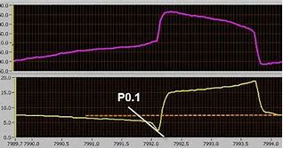
Pulmonary Function Testing and Bedside Pulmonary Mechanics
Complex Bedside Measurements
These measurements are used to evaluate pulmonary status among neuromuscular patients.
The measurements used are;
  P0.1
  Tension time index
Notes:
Through the automated computers, it is possible to measure complex variables of breathing at the bedside. The measurements are used to wean children from mechanical ventilation. They are also used to evaluate the status of pulmonary in a patient suffering from a neuromuscular condition. P0.1 is one such measurement and is used in the same way as MIP. However, P0.1 is used to measure the negative pressure that is produced within the first 100 milliseconds. It helps in the prediction of the ability to sustain weaning or extubation from mechanical ventilation. Tension time index is another measure that helps in the prediction of weaning in mechanical ventilation. The tension time index is the product of the area integrated by the pressure curve and the ratio of time to cycle.

Slide 10
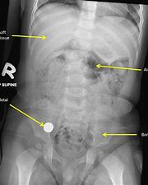
Radiographic Imaging
Characterized by;
  White brightness in metallic and bone orthopedic appearance
  Expanded lungs are black due to absorption of tiny beam
  fluid and organs with soft tissues exhibit gray shades
Notes:
In the anatomy of the normal chest, it is possible to distinguish the radiograph of the chest because the tissues and organs absorb the x-ray beam differently. Due to the more excellent absorption of x-ray, there is white brightness in metallic and bone orthopedic appearance. This is also a result of the image receptor being less exposed. On the other hand, the air absorbs a tiny beam which makes expanded lungs to be black. Finally, fluid and organs with soft tissues exhibit gray shades between the black lungs and white bones. However, if the image receptor is not correctly exposed, it may lead to alteration of grayscale(Walsh, 2018).

Slide 11
Reference
Walsh, B. K. (2018). Neonatal and Pediatric Respiratory Care-E-Book. Elsevier Health Sciences.

